Slide 1
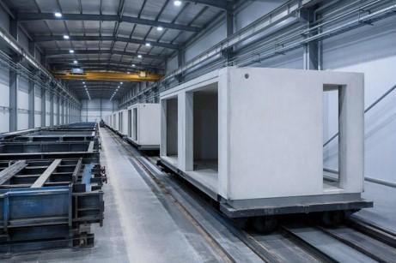

3D Modular Building Technology
C MODULE
2026

Slide 2
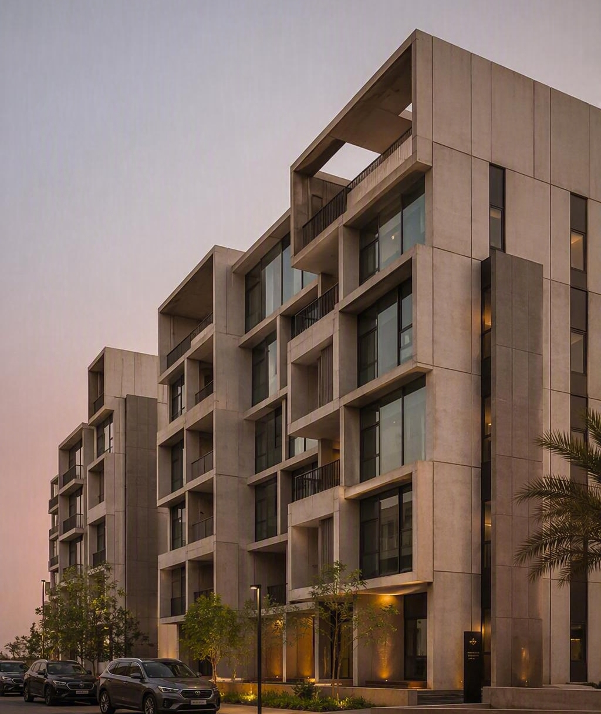
Contents
01
Introduction
02
Modular Buildings
03
Our System
04
System Modular Buildings
05
Our Partners

Slide 3
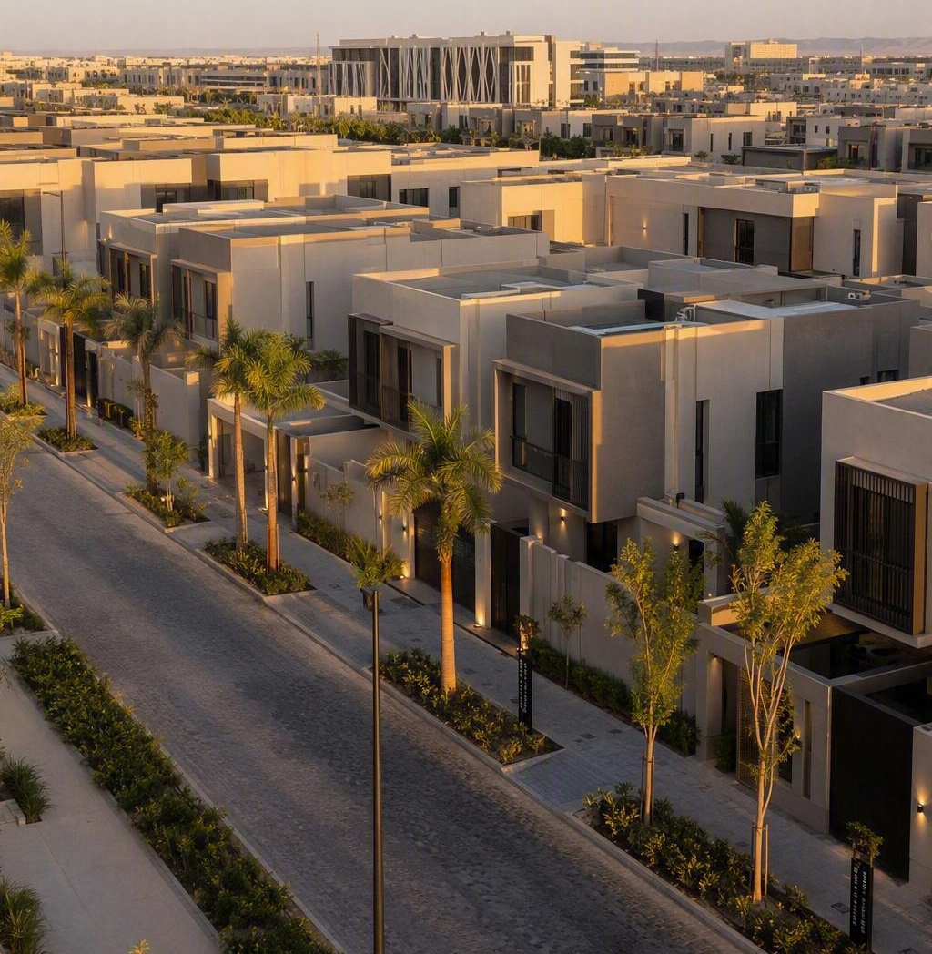
Introduction
Saudi Arabia faces a rapidly growing shortfall in quality buildings across the public and private sectors.
C Module Systems accelerates delivery of quality buildings using 3D modular technology:
Hospitals
Student accommodation
Hotels
Civil defence buildings
Villas & apartments
Schools

Slide 4
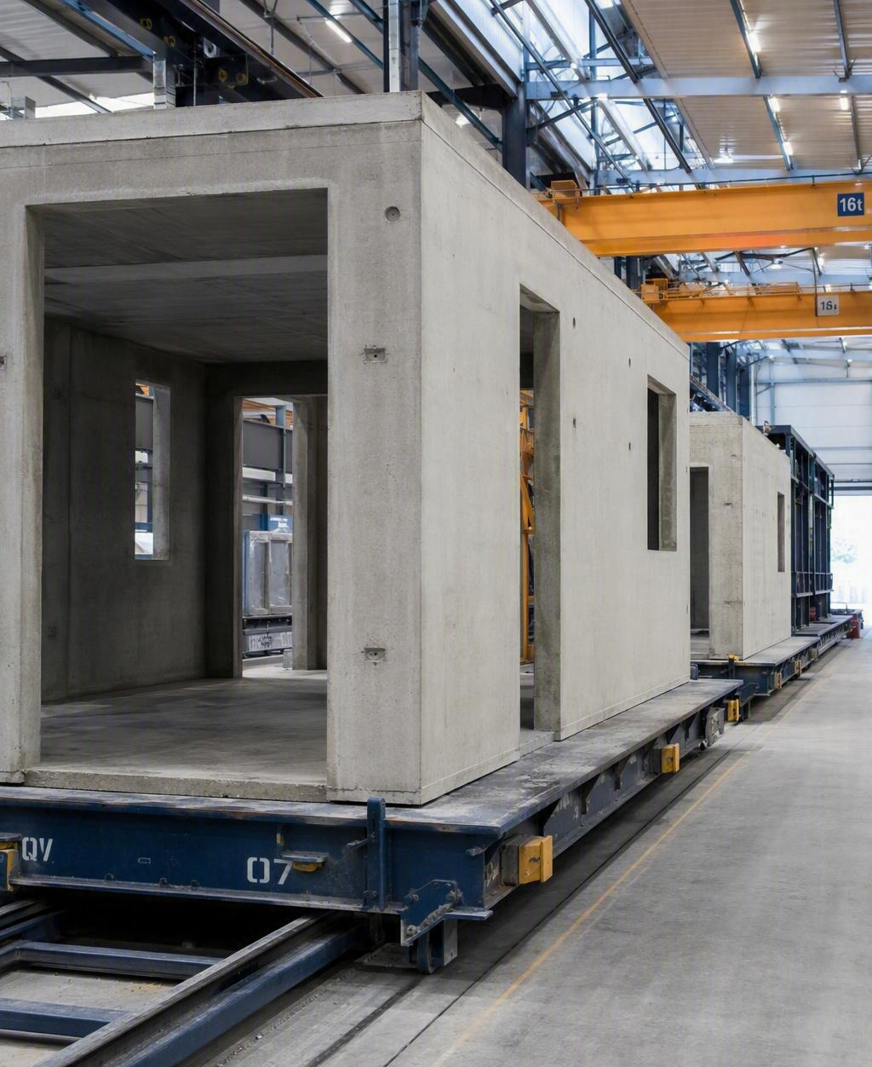
Modular Buildings
01 — 02
Let's dive in

Slide 5
Why Modular Construction
Faster delivery
Controlled quality
Lower waste
Off-site manufacture runs in parallel with site works, compressing programmes for time-critical projects.
Production in a regulated factory environment removes weather and labour variability, cutting errors and rework.
Buildings drive roughly half of global material consumption and waste; factory production sharply reduces both.
Modular construction is the fastest-growing response to the Middle East's booming infrastructure demand.

Slide 6
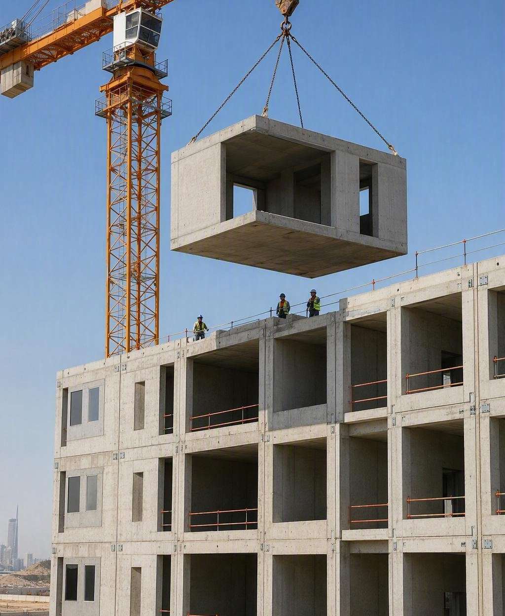
Quality Housing, Delivered at Speed
Proven in Europe for over 35 years, continuously improved with leaner processes and better materials.
XL Module
6.8 × 3.4 × 3.4 m
Annual output
348,000 m²
Villas per year
1,400 (250m2)

Slide 7
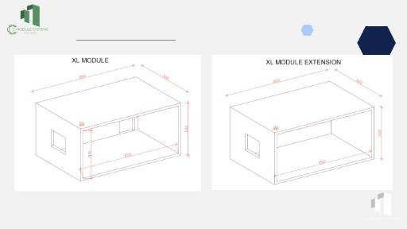
The Module
XL Module
6.8 m × 3.4 m × 3.4 m external | 6.5 × 3.1 × 3.1 internal

Slide 8
Technical Specification
Walls, ceilings & floors | 150 mm
Module weight | 13 – 19 tonnes
Height achievable | Up to 12 floors, subject to seismic zone
Reinforcement | Double-layer mesh with 3D inlays
Accuracy | ± 3 mm
Prefabrication level | Up to 80%, minimising site assembly
Output | 48 modules per 3-shift day, 23 m² each
Fire rating achieved through wall thickness; almost all facade insulation systems can be installed.

Slide 9
System Benefits
348,000 m²
50% / 20%
85%
Yearly capacity over 330 days — 1,850 villas at 280 m²
Time and cost saved versus traditional builds (McKinsey)
Saudi engineers, resources and materials from the local market
80%
12 floors
25 years
Reduction in site works; strip foundations for low-rise
Including corridors, staircases and lift shafts
Structural guarantee;
Austrian technology, proven in Austria, Germany and Poland.

Slide 10
Key Benefits: Build Quality & Sustainability
48 modules
± 3 mm
Low energy
Produced in every 24-hour, three-shift day
Factory accuracy on every module produced
Low consumption in use and a reduced carbon footprint
High insulation
MEP cast in
SASO approved
High insulation values with reduced material wastage
Services cast into modules; balconies added where required
All materials approved, backed by a 25-year structural guarantee
Meets environmental requirements at lower whole-life cost than traditional builds.

Slide 11
Conventional vs Modular: Cost Structure
Cost shifts from site labour and waste into controlled factory production.

Slide 12
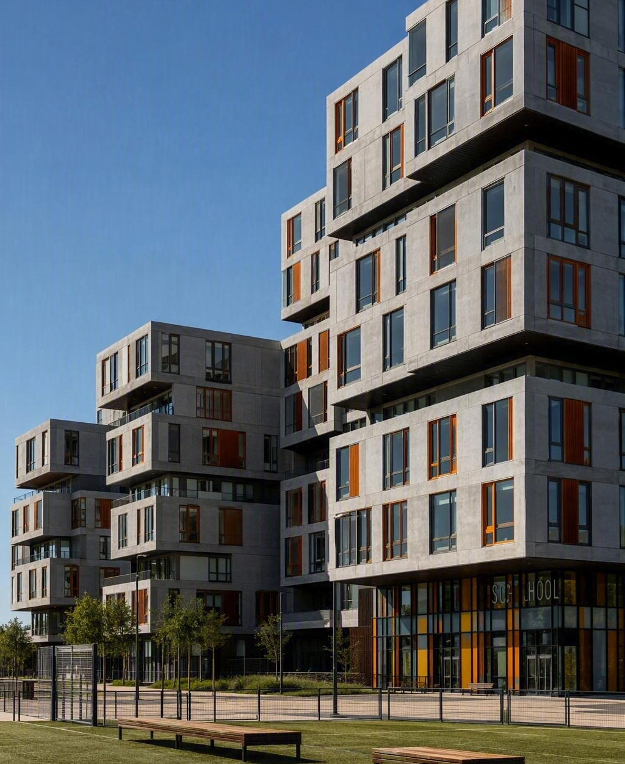
System Modular Buildings
03 — 04

Slide 13
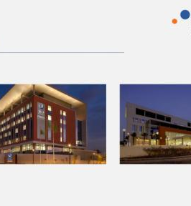
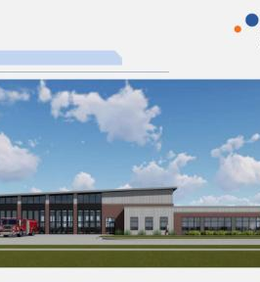
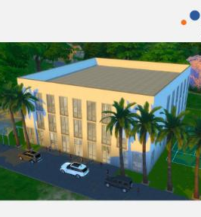
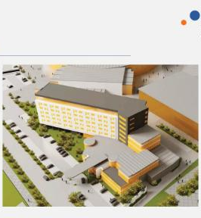
Applications Across Sectors
Hospitals
Civil defence
Schools
Hotels & student housing
Hospitals, fire and ambulance stations, police stations, schools, hotels, apartments, villas and event venues — all from the same module system.

Slide 14
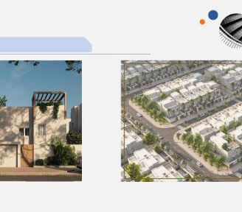
Housing & Community Developments
Villa typologies delivered with standard modules
NHC villa — 247 m²
XL module, ground, first and roof-level overlays
NHC villa — 280 m²
XL module, three-level layout
Flexible blocks
Modules combine into apartments, corridors, stairs and lift shafts

Slide 15
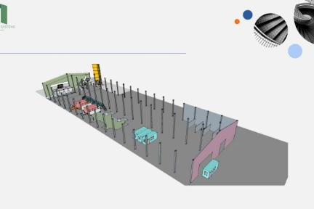
Proposed Factory Facility
Turnkey production capability
12 moulds producing 48 modules every 24 hours, ready for installation

Slide 16
Our Partners
Machines Plants (Austria)
Strategic Mergers & Alliance Group (USA)
Technology partner
Project finance advisory
35 years in production lines for building materials; exclusive GCC representation through MICL.
Specialist project finance and advisory firm focused on measurable results.
Line Concept (Riyadh)
Al-Ajmi · Ajyal · Samama
Design consultancy
Main contractors
Leading architectural and interior design practice driven by research and technology.
Grade A construction and infrastructure contractors in Riyadh and Dammam.

Slide 17
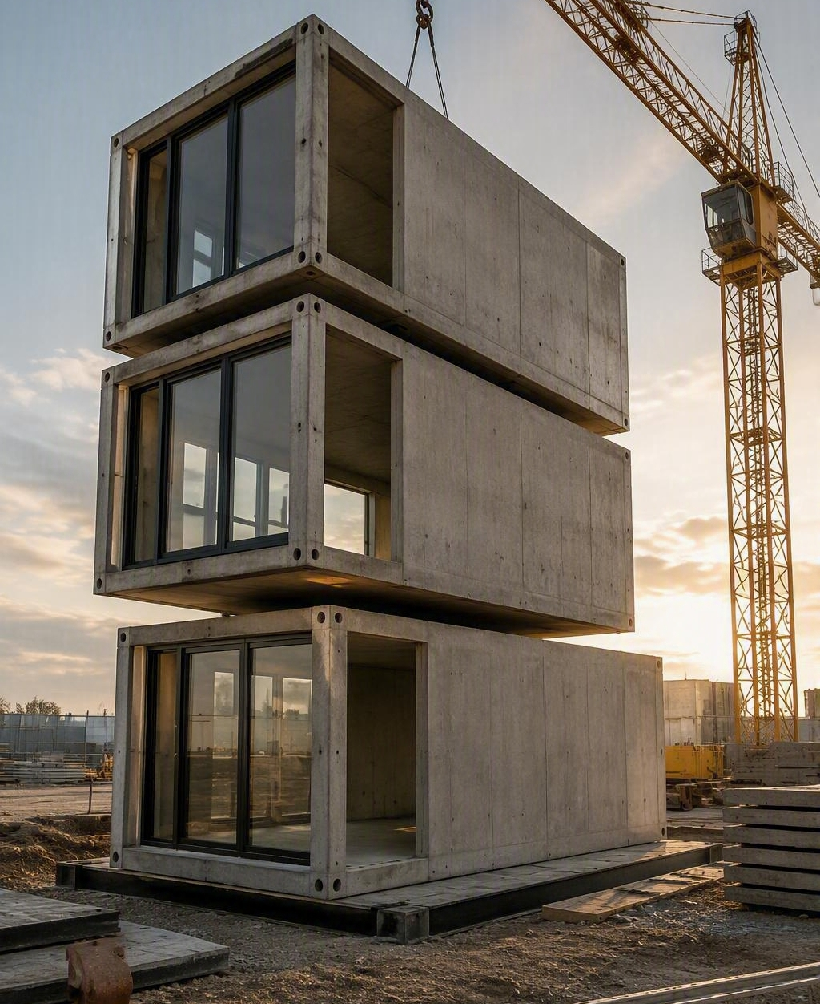
Thank You
Mark International Consulting Ltd
Mark Clift
+966 54 571 1155

